Slide 1
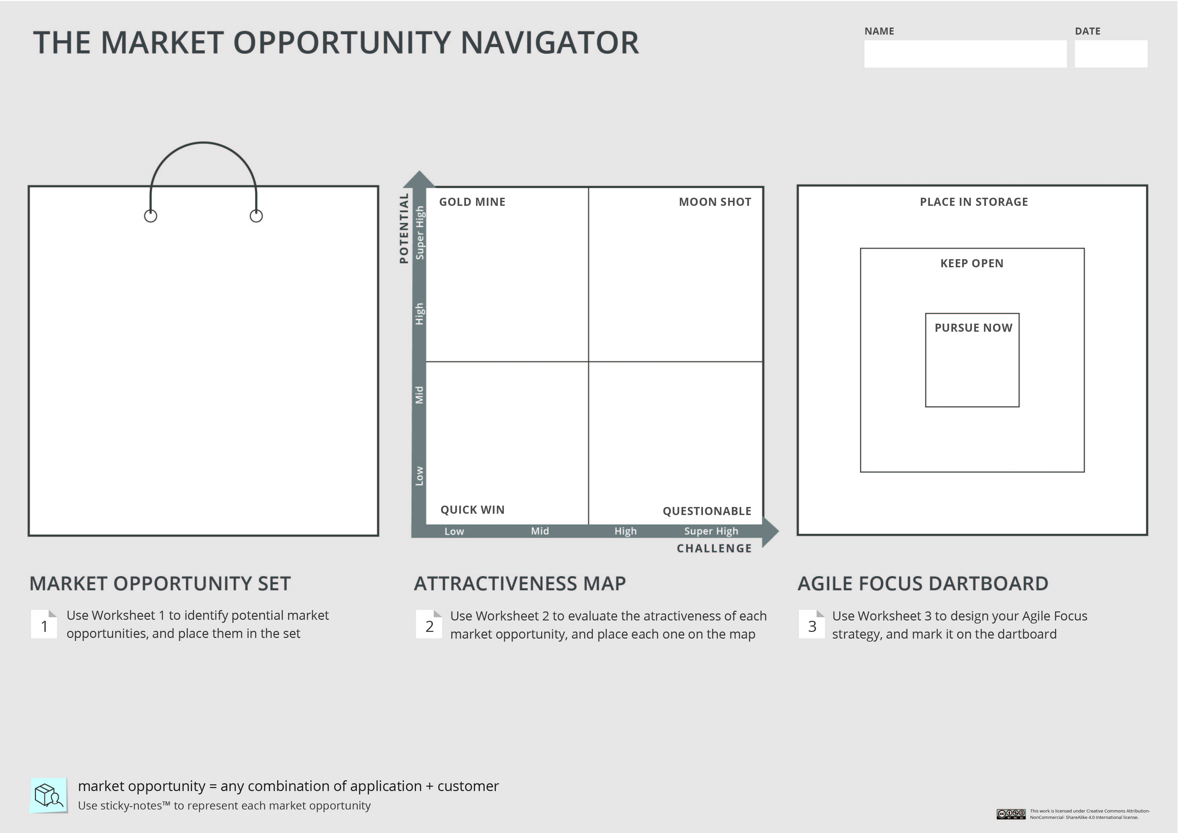
Instructions:
Depict your Market Opportunity Set on the Navigator.
Your project/ startup

Slide 2
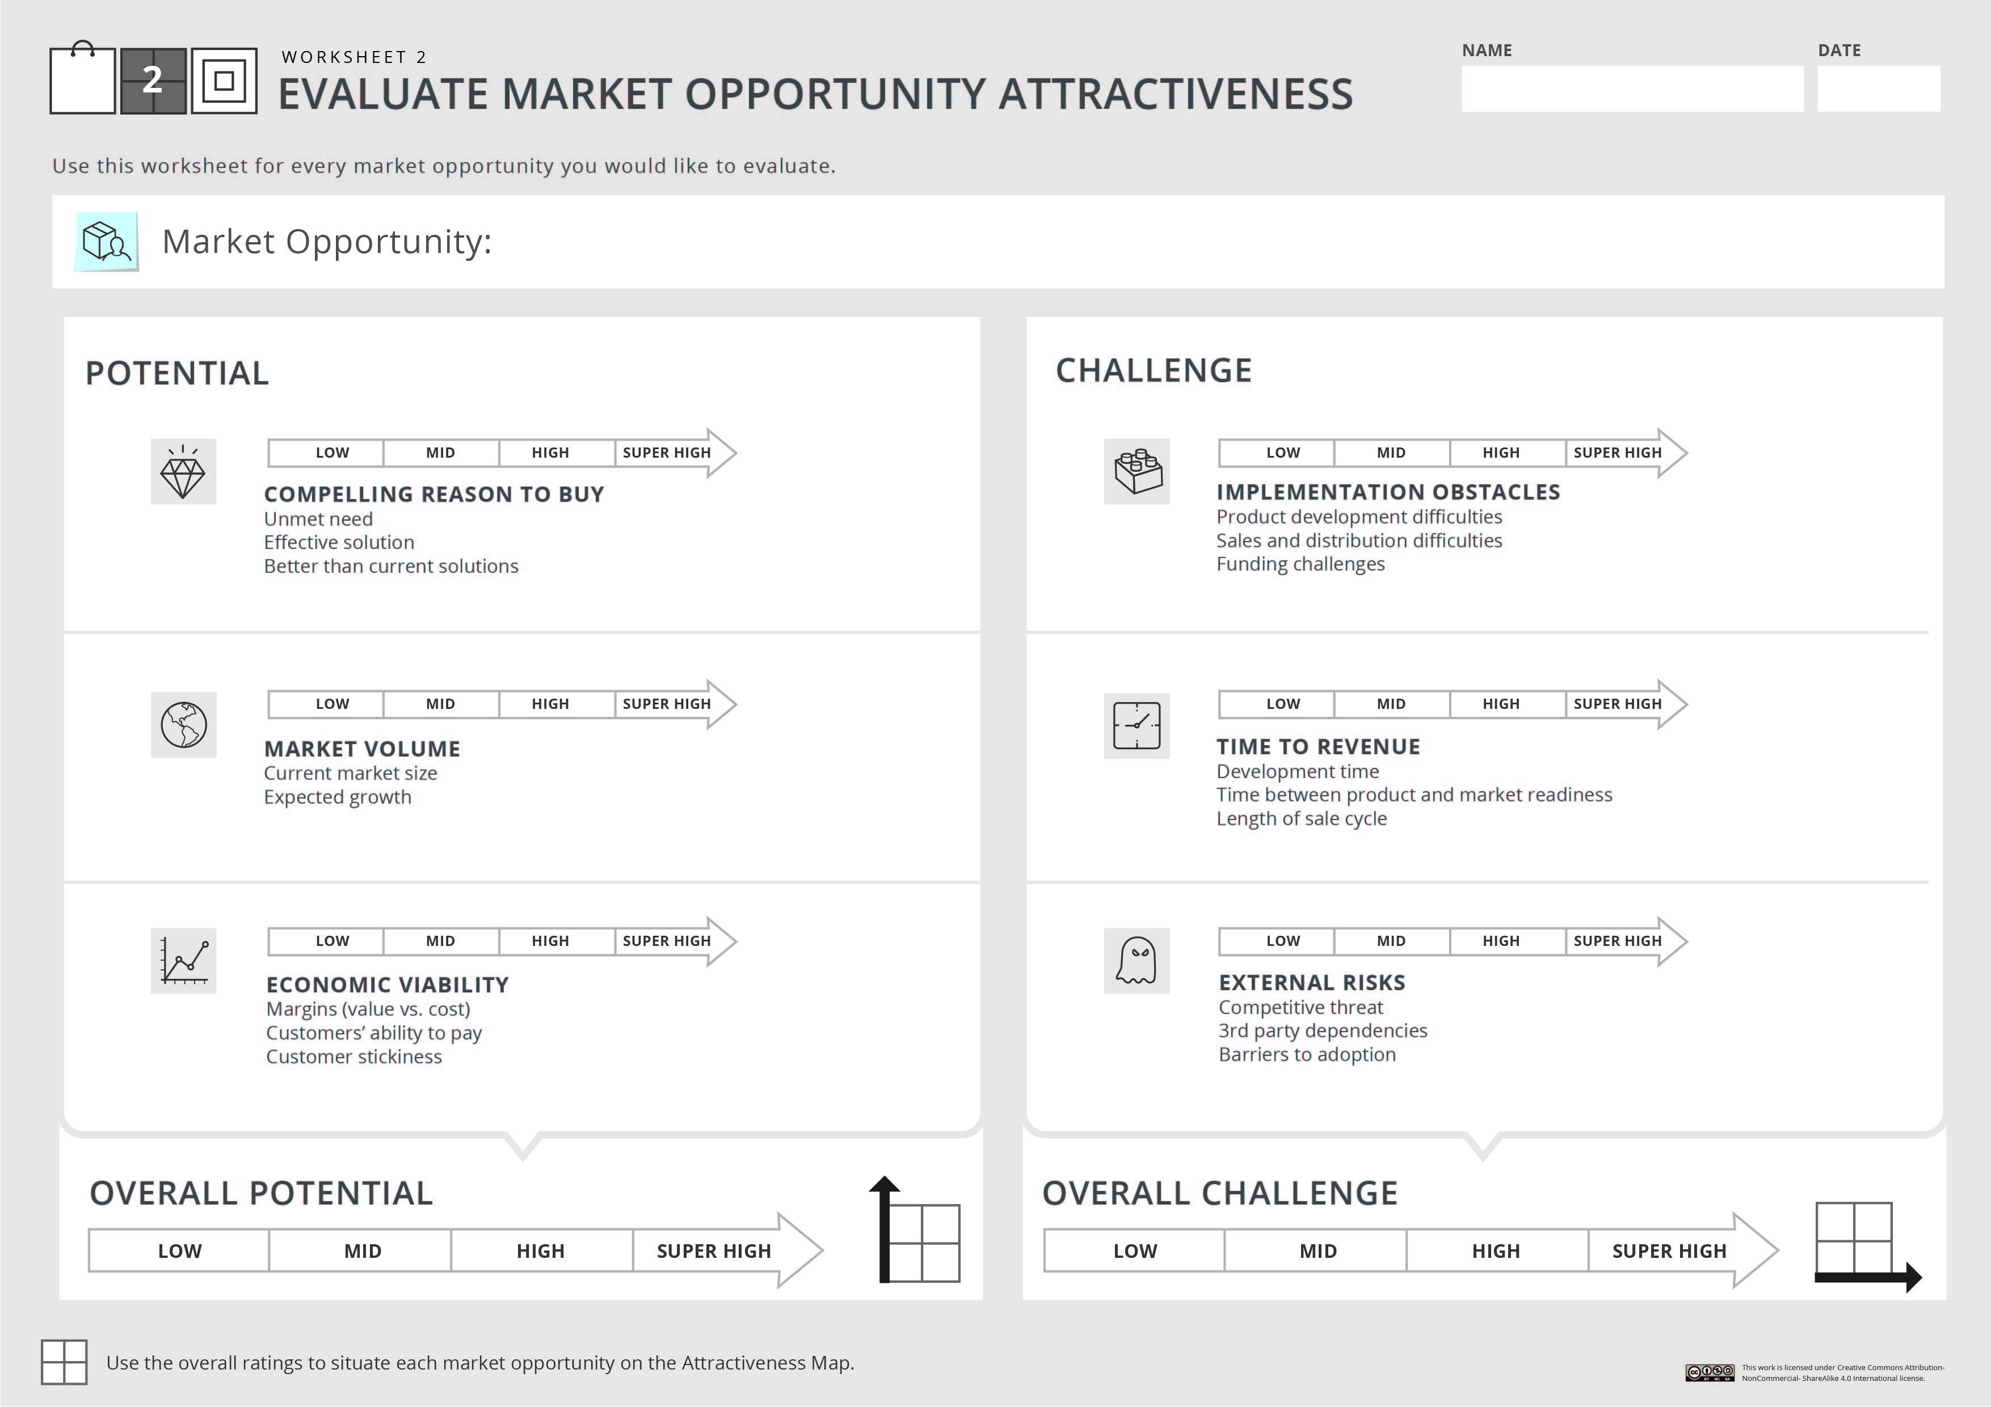

Your project/ startup
Instructions:
Fill in Worksheet 2 -
For each market opportunity in your set. You can use the X signs below to mark your scores.
Market opportunity name
Explain shortly in class what is this opportunity and what are the key considerations that led you to evaluate its potential and challenge
After you feel comfortable with scoring the overall potential and the overall challenge, you can place this market opportunity on the Attractiveness Map

Slide 3
Instructions:
Depict your market opportunities on the Attractiveness Map, based on their overall potential and challenge. You can use the sticky notes below.
Your project/ startup

Slide 4
Analyzing the Attractiveness Map
Instructions:
Examine your Attractiveness Map carefully and shortly describe what can you learn from it: how are your options spread? is there a superior opportunity? Etc.

